Slide 1
CMPG311 – DATABASES
SQL Lessons 1 - 6
Fakulteit Natuur- en Landbouwetenskappe
Faculty of Natural- and Agricultural Sciences

Slide 2
SU6 - Outcomes
Introduction to SQL
Create basic tables, add constraints and insert data;
Write and execute basic SQL expressions (SELECT);
Use character functions, date functions, and conversion functions;
Combine data from different tables (for output purposes); and
Do grouping of data (Making use of functions such as AVG, COUNT, MAX, MIN en SUM).

Slide 3
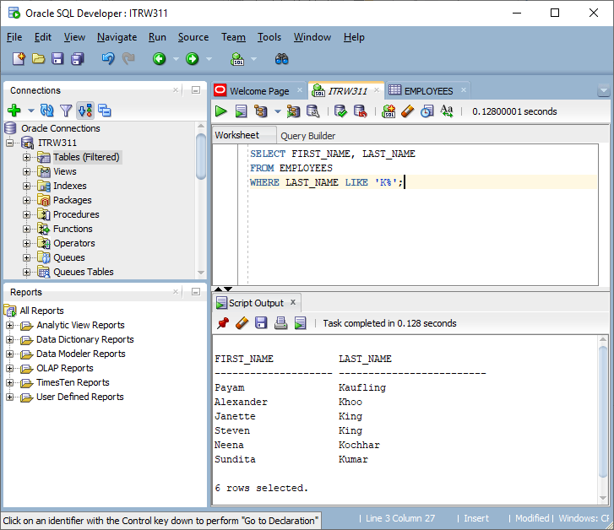
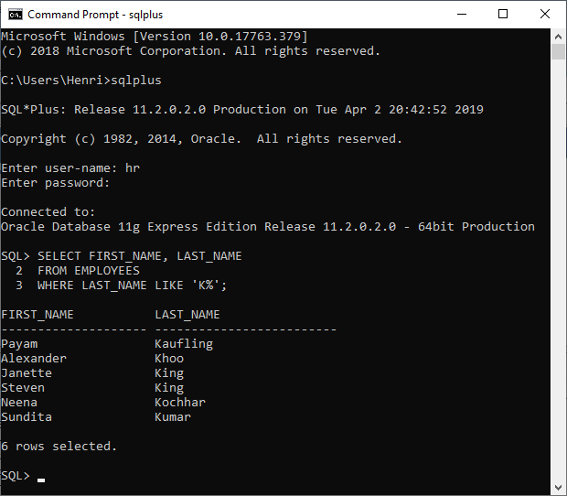
Development environment for SQL (Oracle)
SQL-Developer
SQL *Plus

Slide 4
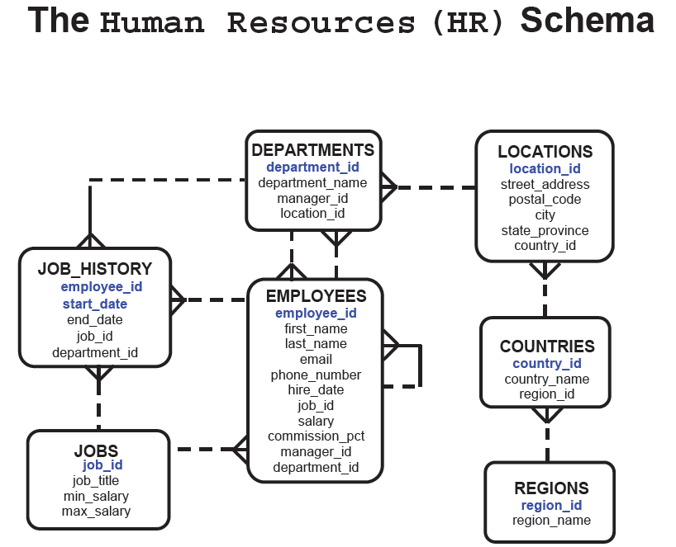
Database and Tables (I-34 tot I-35)

Slide 5
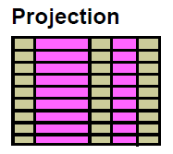
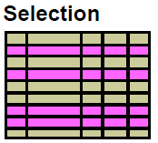
Basic SELECT-statement (Lesson 1)
Projection and selection
Choose from all columns
Choose from specific columns
Use of arithmetic operations (+, -, *, /)
Column alias
String
Use of DISTINCT
Use of DISPLAY

Slide 6
Basic SELECT
SELECT * SELECT *
FROM table; FROM employees;
SELECT department_id, loc_id
FROM employees;

Slide 7
Arithmetic
+ - * /
SELECT last_name, salary, 12 * salary + 300
FROM employees;
SELECT last_name, salary, 12 * (salary + 300)
FROM employees;
SELECT last_name as name, salary, 12 * (salary + 300) “New Salary"
FROM employees;

Slide 8
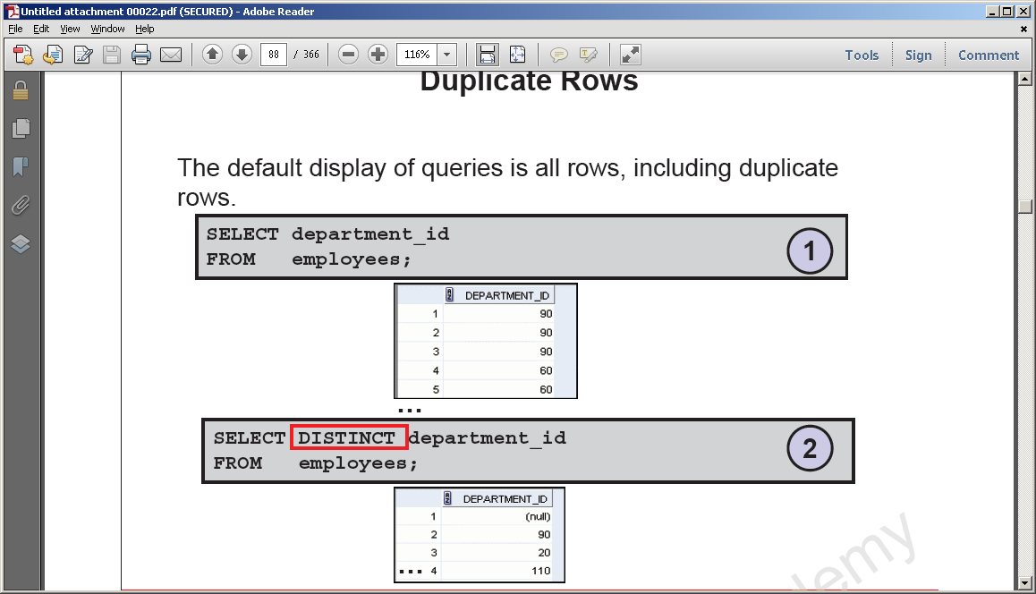
Removing duplicates
SELECT department_id
FROM employees;
SELECT DISTINCT department_id
FROM employees;

Slide 9
Lesson 2
Restricting rows
SELECT employee_id
FROM employees
WHERE department_id = 90
ORDER BY last_name;
SELECT last_name
FROM employees
WHERE hire_date = '07/FEB/07';

Slide 10
Comparisons
= > < >= <=
BETWEEN
IN
LIKE
IS NULL
SELECT last_name
FROM employees
WHERE salary >= 3000;

Slide 11
BETWEEN, IN
SELECT last_name
FROM employees
WHERE salary BETWEEN 2500 AND 3000;
SELECT last_name
FROM employees
WHERE manager_id IN (100, 101, 210);

Slide 12
LIKE
SELECT last_name
FROM employees
WHERE last_name LIKE '_e%' ;
Notes:
Wildcard characters:
_ represents a single char
% represents any sequence of characters

Slide 13
AND, OR, NOT
SELECT last_name
FROM employees
WHERE salary = 3000
AND job_id = 'MANAGER';
SELECT last_name
FROM employees
WHERE salary = 3000
OR job_id = 'MANAGER';

Slide 14
Substitution Variables
& - to prompt the user every time for a value
&& - if you want to reuse the variable value without prompting the user each time
Use single quotation marks for date and character values, e.g. '&job_title'
Use DEFINE command to create and assign a value to a variable

Slide 15
Substitution Variables
DEFINE employee_num = 200
SELECT last_name, salary, department_id
FROM employees
WHERE employee_id = &employee_num;
UNDEFINE employee_num
Run script by pressing F5.

Slide 16
Substitution Variables
SELECT employee_id, last_name
FROM employees
WHERE employee_id = &employee_id;
SELECT last_name, salary*12
FROM employees
WHERE job_id = '&job_title';
SELECT last_name, job_id, &&column_name
FROM employees
ORDER BY &column_name;

Slide 17
Character Functions
LOWER(last_name) king
UPPER(last_name) KING
INITCAP(last_name) King
CONCAT(first_name, last_name) Steven King
SUBSTR(first_name,1,5) Steve
LENGTH(last_name) 4
INSTR(last_name,'n') 3

Slide 18
Character Functions
LPAD(last_name,8,'*') ****King
RPAD(last_name,8,'*') King****
REPLACE(last_name,'K','W') Wing
TRIM('K' FROM 'King') ing

Slide 19
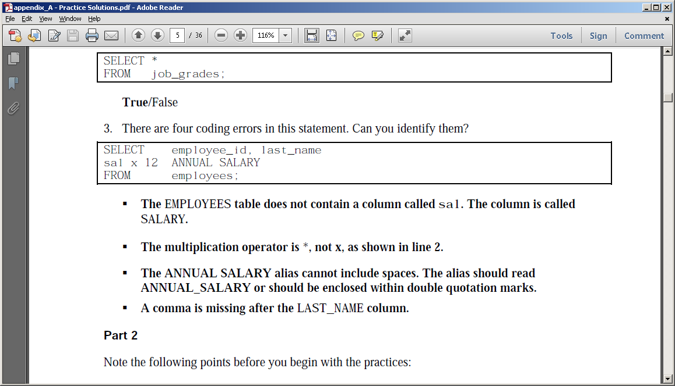
Exercise 1

Slide 20
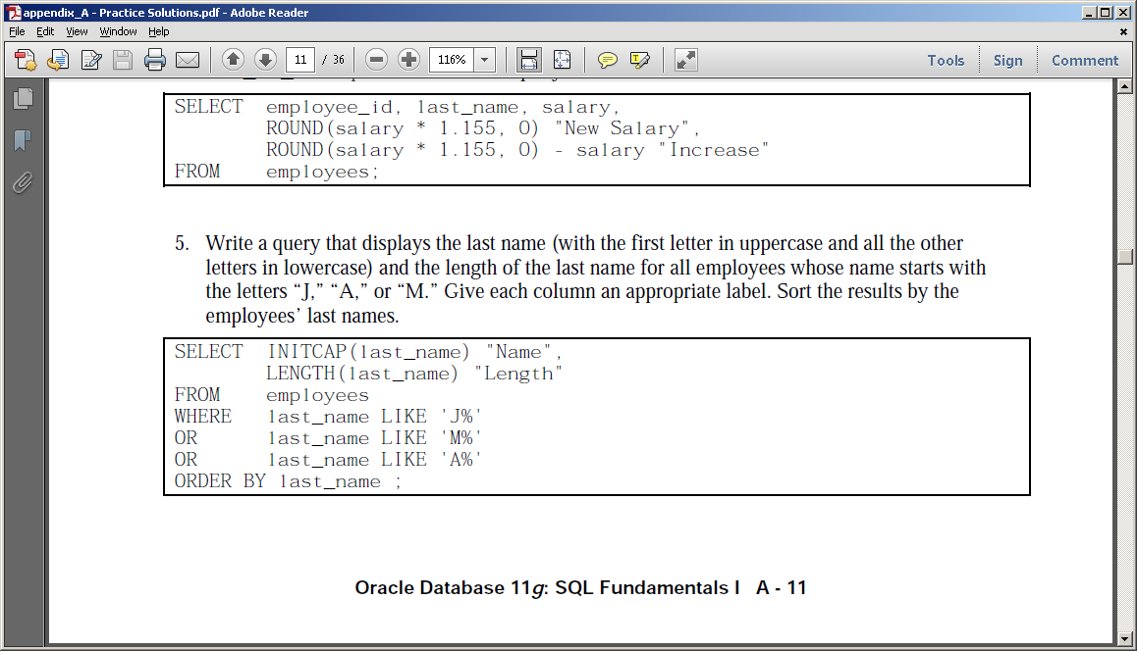
Exercise 2

Slide 21
Exercise 3
Members of the HR department want to have more flexibility with the queries that you are writing. They would like a report that displays the last name and salary of employees who earn more than an amount that the user specifies after a prompt.
a. Enter 12000 when prompted for a value in a dialog box. Click OK.
SELECT last_name, salary
FROM employees
WHERE salary > &sal_amt;

Slide 22
Exercise 4
Display the last names of all employees who have both an “a” and an “e” in their last name.
SELECT last_name
FROM employees
WHERE last_name LIKE '%a%'
AND last_name LIKE '%e%';

Slide 23
Lesson 3

Slide 24
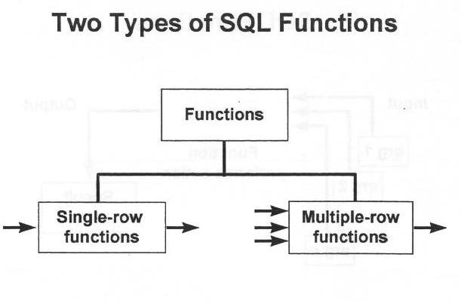
SQL-Functions

Slide 25
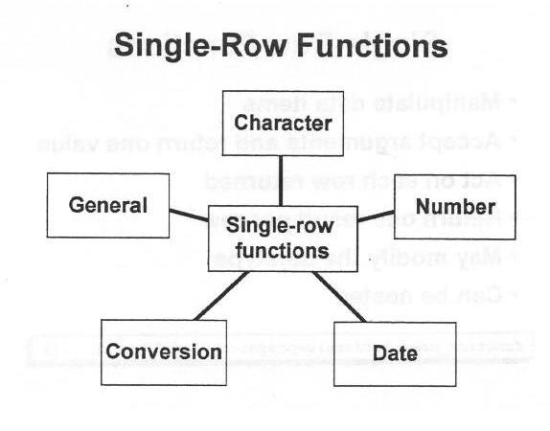
SQL Single Row Functions

Slide 26
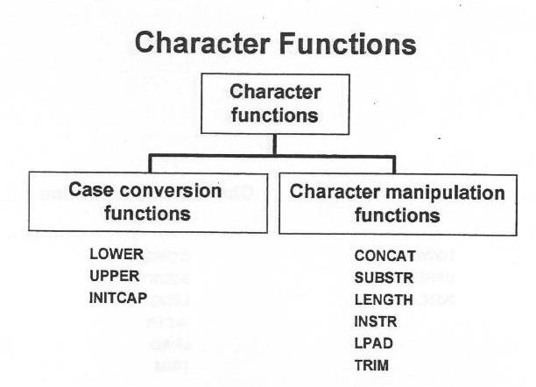
SQL Single Row Functions (cont.)

Slide 27
Capital letters / Lower case letters
SELECT ename FROM emp
WHERE LOWER(ename) = ‘blake’;
SELECT ename FROM emp
WHERE UPPER(ename) =‘BLAKE’;
SELECT INITCAP(ename) FROM emp
WHERE INITCAP(ename) = ‘Blake’;

Slide 28
Capital letters / Lower case letters (cont.)
SELECT ename, job, hiredate
FROM emp
WHERE upper(ename) = ‘BLAKE’;

Slide 29
Character manipulation functions
CONCAT || ||
SUBSTR
LENGTH
INSTR
LPAD
TRIM
SELECT ename, CONCAT(ename,job), LENGTH(ename), INSTR(ename,’A’)
FROM emp
WHERE SUBSTR(job,1,5) = ‘SALES’;

Slide 30
Number Functions
SELECT ROUND(45.923,0) FROM DUAL
SELECT TRUNC(45.923,2) FROM DUAL
SELECT MOD(salary, 1000) FROM EMPLOYEES
Note: DUAL is a dummy table that you can use to view results from functions and calculations

Slide 31
Calculations with dates
Default is DD-MON-YY
SYSDATE is current date and time
A number can be added to a date or subtracted from a date, result is a date
Dates can be deducted, result is the number of days between the 2 dates
Hours can be added to a date by dividing by 24.

Slide 32
Calculations with dates: example
SELECT ename, (SYSDATE-hiredate)/7 WEEKS
FROM emp;
SELECT ename, hiredate + 300
FROM emp;

Slide 33
Date Functions
MONTHS_BETWEEN
Enter the number of months between 2 dates (can be positive or negative)
MONTHS_BETWEEN (SYSDATE, hiredate)
MONTHS_BETWEEN(hiredate,’31-MAR-11’)
Can round off if an integer answer is desired:
ROUND(MONTHS_BETWEEN (SYSDATE, hiredate))
SELECT ename,
ROUND(MONTHS_BETWEEN (SYSDATE, hiredate)) AS months
FROM emp;

Slide 34
Date Functions (2)
ADD_MONTHS
Add a few months to the date and give the new date as output (Can also subtract)
ADD_MONTHS(SYSDATE,6)
ADD_MONTHS(‘18-MAR-11’,-3)
SELECT ename, ADD_MONTHS(hiredate,6) AS promoDate
FROM emp
WHERE hiredate > ‘31-JAN-11’;

Slide 35
Date Functions (3)
NEXT_DAY
Enter the date of the next occurrence of a specific day after the given date.
NEXT_DAY(hiredate,’FRIDAY’)
NEXT_DAY(sysdate,'SUNDAY')
SELECT ename, hiredate, NEXT_DAY(SYSDATE,’MONDAY’) AS monday
FROM emp;

Slide 36
Date Functions (4)
LAST_DAY
Enter the last day of the month that appears in the given date. Answer is date type.
LAST_DAY(hiredate)
LAST_DAY(’03-FEB-11’)
SELECT ename, hiredate, LAST_DAY(SYSDATE) AS month_end
FROM emp;

Slide 37
Date Functions (5)
ROUND
ROUND(‘25-JUL-11’,’MONTH’) ➔ 01-AUG-11
ROUND(‘25-JUL-11’,’YEAR’) ➔ 01-JAN-12
TRUNC
TRUNC(‘25-JUL-11’,’MONTH’) ➔ 01-JUL-11
TRUNC(‘25-JUL-11’,’YEAR’) ➔ 01-JAN-11

Slide 38
Nested Functions
SELECT ename, hiredate,
(NEXT_DAY(ADD_MONTHS(hiredate, 6), ‘MONDAY’), AS REVIEW
FROM emp;
SELECT ROUND(ADD_MONTHS(SYSDATE,3),'YEAR')
FROM DUAL;

Slide 39
Exercise
Lesson 3:
p 3-35, 3-37
Nr. 5, 7, 8

Slide 40
Exercise 3
Create a query to display the last name and salary for all employees. Format the salary to be
15 characters long, left-padded with the $ symbol. Label the column SALARY.
SELECT last_name,
LPAD(salary, 15, '$') SALARY
FROM employees;

Slide 41
Exercise 4
The HR department wants to find the duration of employment for each employee. For each employee, display the last name and calculate the number of months between today and the date on which the employee was hired. Label the column MONTHS_WORKED. Order your
results by the number of months employed. Round the number of months up to the closest
whole number.
SELECT last_name, ROUND(MONTHS_BETWEEN(
SYSDATE, hire_date)) MONTHS_WORKED
FROM employees
ORDER BY months_worked;

Slide 42
Lesson 4

Slide 43
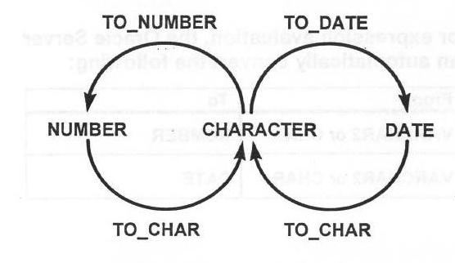
Conversion Functions

Slide 44
Conversion functions TO_CHAR with dates
TO_CHAR(hiredate, ‘MM/YY’)
Can use:
YYYY, YEAR, MM, MONTH, DY, DAY, etc.
SELECT ename, TO_CHAR(hiredate, ‘DD “of” MONTH YYYY HH:MI:SS’)
FROM emp;
SELECT TO_CHAR(SYSDATE, 'DD "of" MONTH YYYY HH:MI:SS')
FROM Dual;

Slide 45
Conversion functions TO_CHAR with numbers
SELECT sal, TO_CHAR(sal, '$9,999.99') AS SALARY
FROM emp;

Slide 46
Dates
INSERT INTO emp (empno, ename, hiredate, deptno)
VALUES(1112,'BRINK','23-Mar-90',10);
SELECT ename, TO_CHAR(hiredate,'YYYY')
FROM emp;

Slide 47
Elements of the Date Format Model
Element
Result
YYYY
Full year in numbers
YEAR
Year spelled out (in English)
MM
Two-digit value for the month
MONTH
Full name of the month
MON
Three-letter abbreviation of the month
DY
Three-letter abbreviation of the day of the week
DAY
Full name of the day of the week
DD
Numeric day of the month

Slide 48
Using the TO_CHAR Function with Numbers
TO_CHAR(number, 'format_model')
These are some of the format elements that you can use with the TO_CHAR function to display a number value as a character:
Element
Result
9
Represents a number
0
Forces a zero to be displayed
$
Places a floating dollar sign
L
Uses the floating local currency symbol
.
Prints a decimal point
,
Prints a comma as a thousands indicator
Notes:
Using the TO_CHAR Function with Numbers
When working with number values, such as character strings, you should convert those numbers to the character data type using the TO_CHAR function, which translates a value of NUMBER data type to VARCHAR2 data type. This technique is especially useful with concatenation.

Slide 49
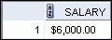
Using the TO_CHAR Function with Numbers
SELECT TO_CHAR(salary, '$99,999.00') SALARY
FROM employees
WHERE last_name = 'Ernst';
Notes:
Using the TO_CHAR Function with Numbers (continued)
The Oracle server displays a string of number signs (#) in place of a whole number whose digits exceed the number of digits provided in the format model.
The Oracle server rounds the stored decimal value to the number of decimal places provided in the format model.

Slide 50
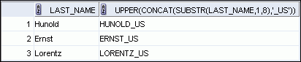
Nesting Functions
SELECT last_name,
UPPER(CONCAT(SUBSTR (LAST_NAME, 1, 8), '_US'))
FROM employees
WHERE department_id = 60;
Notes:
Nesting Functions (continued)
The slide example displays the last names of employees in department 60. The evaluation of the SQL statement involves three steps:
1. The inner function retrieves the first eight characters of the last name.
Result1 = SUBSTR (LAST_NAME, 1, 8)
2. The outer function concatenates the result with _US.
Result2 = CONCAT(Result1, '_US')
3. The outermost function converts the results to uppercase.
The entire expression becomes the column heading because no column alias was given.
Example:
Display the date of the next Friday that is six months from the hire date. The resulting date should appear as Friday, August 13th, 1999. Order the results by hire date.
SELECT TO_CHAR(NEXT_DAY(ADD_MONTHS
(hire_date, 6), 'FRIDAY'),
'fmDay, Month ddth, YYYY')
"Next 6 Month Review"
FROM employees
ORDER BY hire_date;

Slide 51
NVL Function
Converts a null value to an actual value
NVL(comm,0)
NVL(hiredate,’01-JAN-97’)
NVL(job,’No job yet’)
NVL(TO_CHAR(comm),’No commission’);
SELECT comm, NVL(TO_CHAR(comm),'No commission') AS comm2
FROM emp;

Slide 52
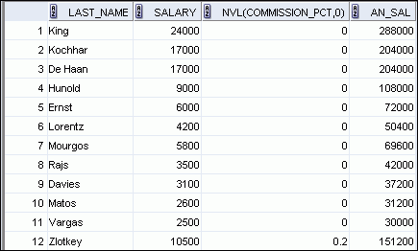
Using the NVL Function
SELECT last_name, salary, NVL(commission_pct, 0),
(salary*12) + (salary*12*NVL(commission_pct, 0)) AN_SAL
FROM employees;
1
2
…
1
2
Notes:
Using the NVL Function
To calculate the annual compensation of all employees, you need to multiply the monthly salary by 12 and then add the commission percentage to the result:
SELECT last_name, salary, commission_pct,
(salary*12) + (salary*12*commission_pct) AN_SAL
FROM employees;
Notice that the annual compensation is calculated for only those employees who earn a commission. If any column value in an expression is null, the result is null. To calculate values for all employees, you must convert the null value to a number before applying the arithmetic operator. In the example in the slide, the NVL function is used to convert null values to zero.
…
…

Slide 53
Exercise Lesson 3, 4
Lesson 3 nrs 1, 2, 3, 4, 5, 6, 7
Lesson 4 nrs 1, 2, 3, 4

Slide 54
Exercise 5
Create a query that displays the employees’ last names and commission percentage. If an employee does not earn commission, show “No Commission.” Label the column as COMM.
SELECT last_name,
NVL(TO_CHAR(commission_pct), 'No Commission') COMM
FROM employees;

Slide 55
Lesson 5

Slide 56
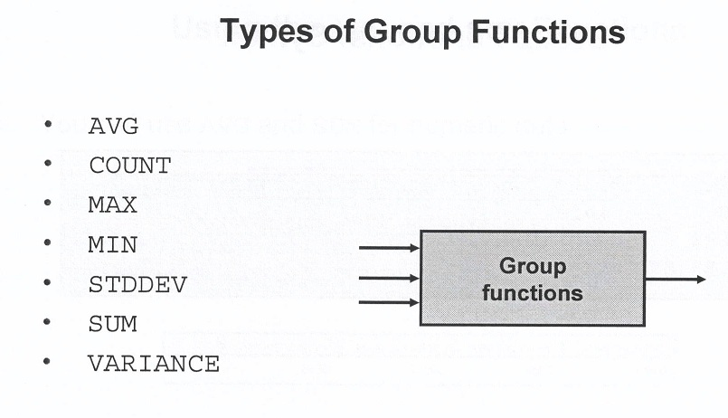
Group Functions

Slide 57
AVG, SUM, MIN, MAX
SELECT AVG(salary), MAX(salary), MIN(salary), SUM(salary) FROM employees;
SELECT MIN(hire_date), MAX(hire_date) FROM employees;
SELECT MIN(last_name), MAX(last_name) FROM employees;

Slide 58
COUNT
SELECT COUNT(*) FROM employees WHERE department_id = 50;
SELECT COUNT(commission_pct) FROM employees WHERE department_id = 50;
SELECT COUNT(DISTINCT department_id) FROM employees WHERE department_id = 50;

Slide 59
Group Functions and NULL values
SELECT AVG(commission_pct) FROM employees;
SELECT AVG(NVL(commission_pct, 0)) FROM employees;

Slide 60
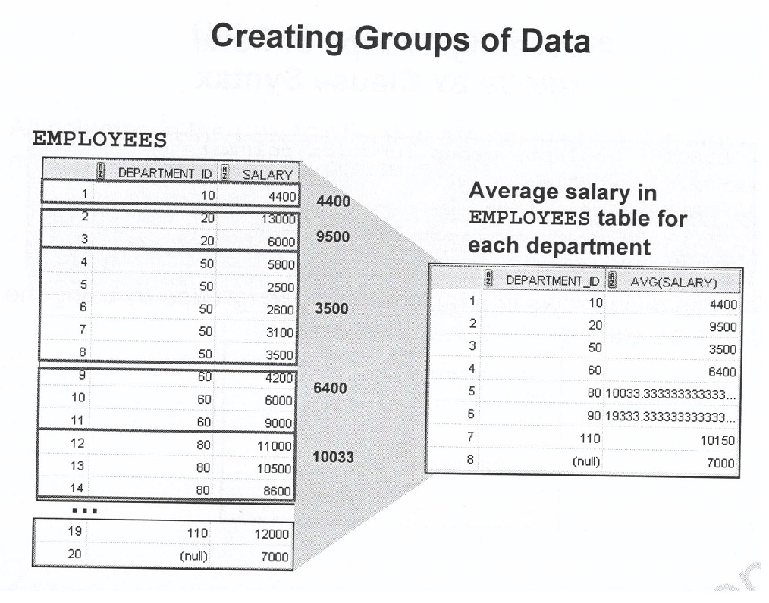
Groups of data

Slide 61
GROUP BY
SELECT department_id, AVG(salary) FROM employees GROUP BY department_id;
SELECT department_id, AVG(salary) FROM employees GROUP BY department_id ORDER BY AVG(salary);

Slide 62
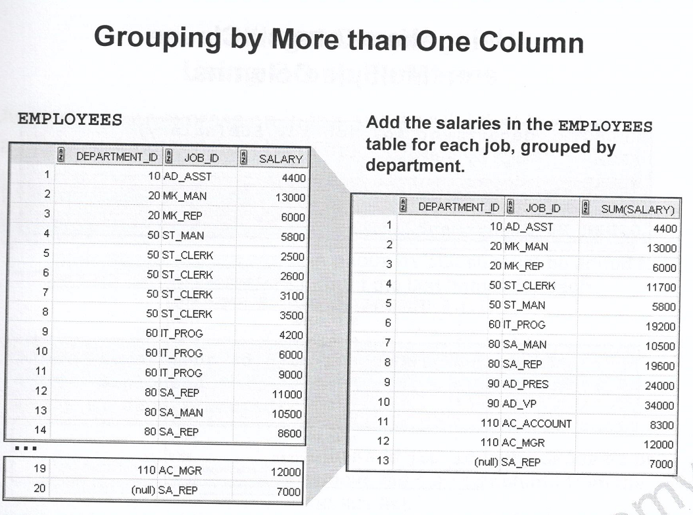
GROUP BY – more than one column

Slide 63
More than one column
SELECT department_id, job_id, SUM(salary) FROM employees GROUP BY department_id, job_id ORDER BY job_id;

Slide 64
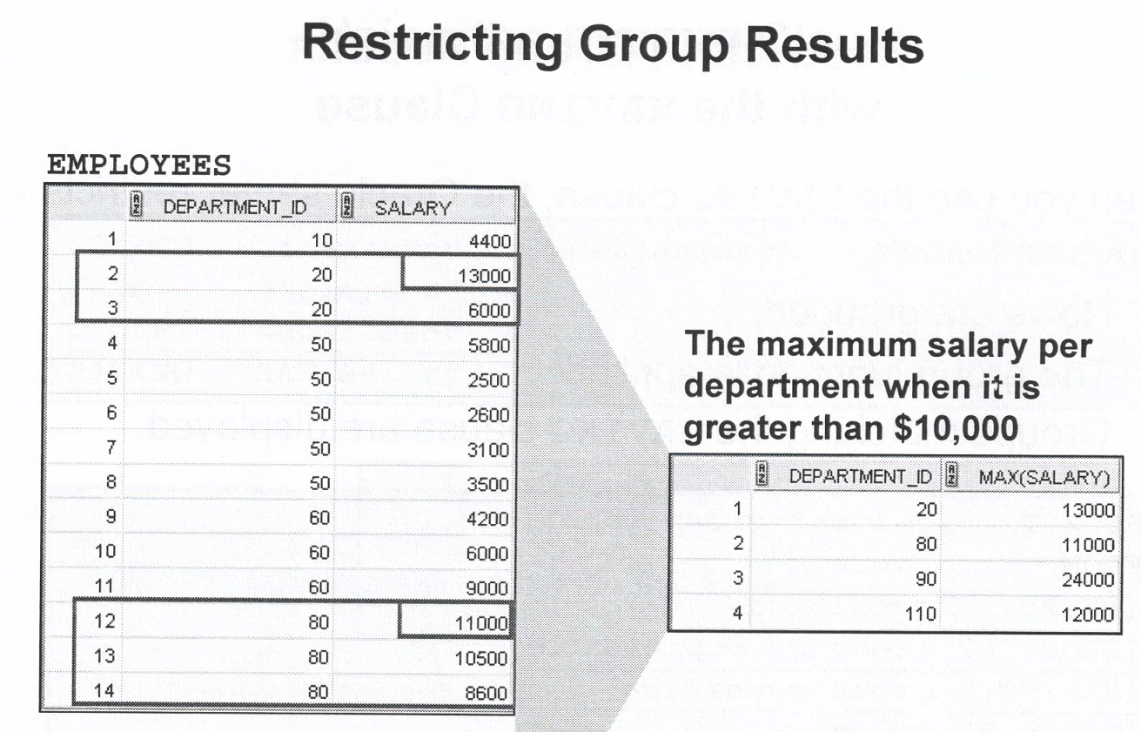
Restricting results

Slide 65
Restricting results
SELECT department_id, MAX(salary) FROM employees GROUP BY department_id HAVING MAX(salary) > 10000;

Slide 66
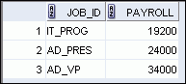
Using the HAVING Clause
SELECT job_id, SUM(salary) PAYROLL
FROM employees
WHERE job_id NOT LIKE '%REP%'
GROUP BY job_id
HAVING SUM(salary) > 13000
ORDER BY SUM(salary);
Notes:
Using the HAVING Clause (continued)
The example in the slide displays the job ID and total monthly salary for each job that has a total payroll exceeding $13,000. The example excludes sales representatives and sorts the list by the total monthly salary.

Slide 67
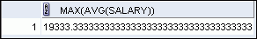
Nesting Group Functions
Display the maximum average salary:
SELECT MAX(AVG(salary))
FROM employees
GROUP BY department_id;
Notes:
Nesting Group Functions
Group functions can be nested to a depth of two functions. The example in the slide calculates the average salary for each department_id and then displays the maximum average salary.
Note that GROUP BY clause is mandatory when nesting group functions.

Slide 68
Exercise
SQL, Lesson 5: pp. 5-30 tot 5-32, Problems 5, 6, 7, 8, 9.

Slide 69
Exercise 6
Find the highest, lowest, sum, and average salary of all employees. Label the columns Maximum, Minimum, Sum, and Average, respectively. Round your results to the nearest whole number.
SELECT ROUND(MAX(salary),0) Maximum,
ROUND(MIN(salary),0) Minimum,
ROUND(SUM(salary),0) Sum,
ROUND(AVG(salary),0) Average
FROM employees;

Slide 70
Exercise 7
Display the minimum, maximum, sum, and
average salary for each job type on the employee table.
SELECT job_id, ROUND(MAX(salary),0) "Maximum",
ROUND(MIN(salary),0) "Minimum",
ROUND(SUM(salary),0) "Sum",
ROUND(AVG(salary),0) "Average"
FROM employees
GROUP BY job_id;

Slide 71
Displaying Data from Multiple Tables
Lesson 6

Slide 72
Objectives
On completion of this study unit you should be able to:
Aggregate data (for output purposes) from different tables; and
Use sub-queries;
Use SET operators;
Data in tables can change; and
can explain how database transactions are managed.
Notes:
Objectives
This lesson explains how to obtain data from more than one table. A join is used to view information from multiple tables. Therefore, you can join tables together to view information from more than one table.
Note: Information on joins is found in the section on SQL Queries and Subqueries: Joins in Oracle Database SQL Language Reference 11g, Release 1 (11.1).

Slide 73
Lesson Agenda
Types of JOINS and its syntax
Natural join:
USING clause
ON clause
Self-join
Nonequijoins
OUTER join:
LEFT OUTER join
RIGHT OUTER join
FULL OUTER join
Cartesian product
Cross join

Slide 74
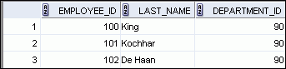
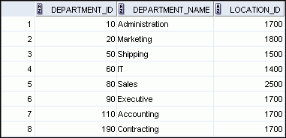
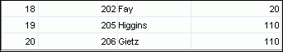
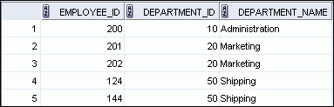
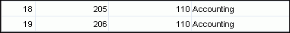
Obtaining Data from Multiple Tables
EMPLOYEES
DEPARTMENTS
…
…
Notes:
Obtaining Data from Multiple Tables
Sometimes you need to use data from more than one table. In the example in the slide, the report displays data from two separate tables:
Employee IDs exist in the EMPLOYEES table.
Department IDs exist in both the EMPLOYEES and DEPARTMENTS tables.
Department names exist in the DEPARTMENTS table.
To produce the report, you need to link the EMPLOYEES and DEPARTMENTS tables, and access data from both of them.

Slide 75
Joining Tables Using SQL:1999 Syntax
Use a join to query data from more than one table:
SELECT table1.column, table2.column
FROM table1
[NATURAL JOIN table2] |
[JOIN table2 USING (column_name)] |
[JOIN table2
ON (table1.column_name = table2.column_name)]|
[LEFT|RIGHT|FULL OUTER JOIN table2
ON (table1.column_name = table2.column_name)]|
[CROSS JOIN table2];
Notes:
Joining Tables Using SQL:1999 Syntax
In the syntax:
table1.column denotes the table and the column from which data is retrieved
NATURAL JOIN joins two tables based on the same column name
JOIN table2 USING column_name performs an equijoin based on the column name
JOIN table2 ON table1.column_name = table2.column_name performs an equijoin based on the condition in the ON clause
LEFT/RIGHT/FULL OUTER is used to perform outer joins
CROSS JOIN returns a Cartesian product from the two tables
For more information, see the section titled SELECT in Oracle Database SQL Language Reference 11g, Release 1 (11.1).

Slide 76
Qualifying Ambiguous Column Names
Use table prefixes to qualify column names that are in multiple tables.
Use table prefixes to improve performance.
Instead of full table name prefixes, use table aliases.
Table alias gives a table a shorter name:
Keeps SQL code smaller, uses less memory
Use column aliases to distinguish columns that have identical names, but reside in different tables.
Notes:
Qualifying Ambiguous Column Names
When joining two or more tables, you need to qualify the names of the columns with the table name to avoid ambiguity. Without the table prefixes, the DEPARTMENT_ID column in the SELECT list could be from either the DEPARTMENTS table or the EMPLOYEES table. It is necessary to add the table prefix to execute your query. If there are no common column names between the two tables, there is no need to qualify the columns. However, using the table prefix improves performance, because you tell the Oracle server exactly where to find the columns.
However, qualifying column names with table names can be time consuming, particularly if the table names are lengthy. Instead, you can use table aliases. Just as a column alias gives a column another name, a table alias gives a table another name. Table aliases help to keep SQL code smaller, therefore using less memory.
The table name is specified in full, followed by a space and then the table alias. For example, the EMPLOYEES table can be given an alias of e, and the DEPARTMENTS table an alias of d.
Guidelines
Table aliases can be up to 30 characters in length, but shorter aliases are better than longer ones.
If a table alias is used for a particular table name in the FROM clause, then that table alias must be substituted for the table name throughout the SELECT statement.
Table aliases should be meaningful.
The table alias is valid for only the current SELECT statement.

Slide 77
Creating Natural Joins
The NATURAL JOIN clause is based on all columns in the two tables that have the same name.
It selects rows from the two tables that have equal values in all matched columns.
If the columns having the same names have different data types, an error is returned.
Notes:
Creating Natural Joins
You can join tables automatically based on the columns in the two tables that have matching data types and names. You do this by using the NATURAL JOIN keywords.
Note: The join can happen on only those columns that have the same names and data types in both tables. If the columns have the same name but different data types, then the NATURAL JOIN syntax causes an error.

Slide 78
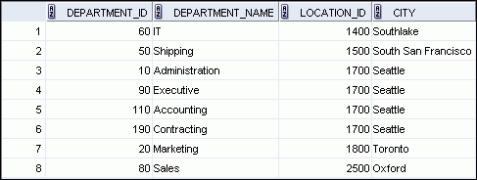
Retrieving Records with Natural Joins
SELECT department_id, department_name,
location_id, city
FROM departments
NATURAL JOIN locations ;
Notes:
Retrieving Records with Natural Joins
In the example in the slide, the LOCATIONS table is joined to the DEPARTMENT table by the LOCATION_ID column, which is the only column of the same name in both tables. If other common columns were present, the join would have used them all.
Natural Joins with a WHERE Clause
Additional restrictions on a natural join are implemented by using a WHERE clause. The following example limits the rows of output to those with a department ID equal to 20 or 50:
SELECT department_id, department_name,
location_id, city
FROM departments
NATURAL JOIN locations
WHERE department_id IN (20, 50);

Slide 79
Creating Joins with the USING Clause
If several columns have the same names but the data types do not match, natural join can be applied using the USING clause to specify the columns that should be used for an equijoin.
Use the USING clause to match only one column when more than one column matches.
The NATURAL JOIN and USING clauses are mutually exclusive (cannot both be true at the same time).
Notes:
Creating Joins with the USING Clause
Natural joins use all columns with matching names and data types to join the tables. The USING clause can be used to specify only those columns that should be used for an equijoin.

Slide 80
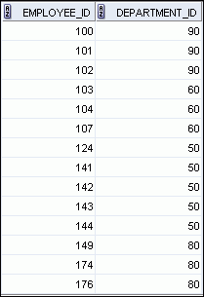
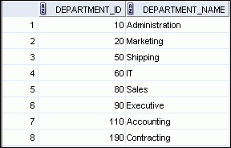
Joining Column Names
EMPLOYEES
DEPARTMENTS
Primary key
…
Foreign key
Notes:
Joining Column Names
To determine an employee’s department name, you compare the value in the DEPARTMENT_ID column in the EMPLOYEES table with the DEPARTMENT_ID values in the DEPARTMENTS table. The relationship between the EMPLOYEES and DEPARTMENTS tables is an equijoin; that is, values in the DEPARTMENT_ID column in both the tables must be equal. Frequently, this type of join involves primary and foreign key complements.
Note: Equijoins are also called simple joins or inner joins.

Slide 81
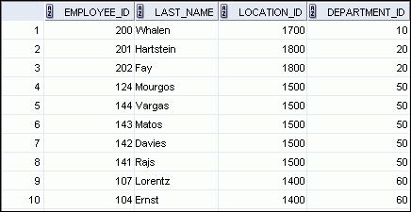
Retrieving Records with the USING Clause
SELECT employee_id, last_name,
location_id, department_id
FROM employees JOIN departments
USING (department_id) ;
…
Notes:
Retrieving Records with the USING Clause
In the example in the slide, the DEPARTMENT_ID columns in the EMPLOYEES and DEPARTMENTS tables are joined and thus the LOCATION_ID of the department where an employee works is shown.

Slide 82
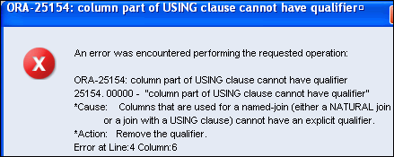
Using Table Aliases with the USING Clause
Do not qualify a column that is used in the USING clause.
If the same column is used elsewhere in the SQL statement, do not alias it.
SELECT l.city, d.department_name
FROM locations l JOIN departments d
USING (location_id)
WHERE d.location_id = 1400;
Notes:
Using Table Aliases with the USING clause
When joining with the USING clause, you cannot qualify a column that is used in the USING clause itself. Furthermore, if that column is used anywhere in the SQL statement, you cannot alias it. For example, in the query mentioned in the slide, you should not alias the location_id column in the WHERE clause because the column is used in the USING clause.
The columns that are referenced in the USING clause should not have a qualifier (table name or alias) anywhere in the SQL statement. For example, the following statement is valid:
SELECT l.city, d.department_name
FROM locations l JOIN departments d USING (location_id)
WHERE location_id = 1400;
Because, other columns that are common in both the tables, but not used in the USING clause, must be prefixed with a table alias otherwise you get the “column ambiguously defined” error.
In the following statement, manager_id is present in both the employees and departments table and if manager_id is not prefixed with a table alias, it gives a “column ambiguously defined” error.
The following statement is valid:
SELECT first_name, d.department_name, d.manager_id
FROM employees e JOIN departments d USING (department_id)
WHERE department_id = 50;

Slide 83
Creating Joins with the ON Clause
The join condition for the natural join is basically an equijoin of all columns with the same name.
Use the ON clause to specify arbitrary conditions or specify columns to join.
The join condition is separated from other search conditions.
The ON clause makes code easy to understand.
Notes:
Creating Joins with the ON Clause
Use the ON clause to specify a join condition. With this, you can specify join conditions separate from any search or filter conditions in the WHERE clause.

Slide 84
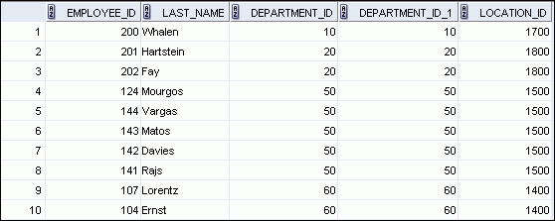
Retrieving Records with the ON Clause
SELECT e.employee_id, e.last_name, e.department_id,
d.department_id, d.location_id
FROM employees e JOIN departments d
ON (e.department_id = d.department_id);
…
Notes:
Retrieving Records with the ON Clause
In this example, the DEPARTMENT_ID columns in the EMPLOYEES and DEPARTMENTS table are joined using the ON clause. Wherever a department ID in the EMPLOYEES table equals a department ID in the DEPARTMENTS table, the row is returned. The table alias is necessary to qualify the matching column_names.
You can also use the ON clause to join columns that have different names. The parenthesis around the joined columns as in the slide example, (e.department_id = d.department_id) is optional. So, even ON e.department_id = d.department_id will work.
Note: SQL Developer suffixes a ‘_1’ to differentiate between the two department_ids.

Slide 85
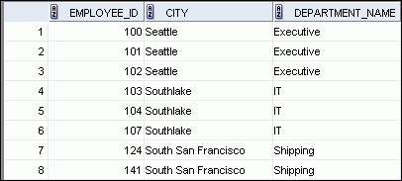
Creating Three-Way Joins with the ON Clause
SELECT employee_id, city, department_name
FROM employees e
JOIN departments d
ON d.department_id = e.department_id
JOIN locations l
ON d.location_id = l.location_id;
…
Notes:
Creating Three-Way Joins with the ON Clause
A three-way join is a join of three tables. In SQL:1999–compliant syntax, joins are performed from left to right. So, the first join to be performed is EMPLOYEES JOIN DEPARTMENTS. The first join condition can reference columns in EMPLOYEES and DEPARTMENTS but cannot reference columns in LOCATIONS. The second join condition can reference columns from all three tables.
Note: The code example in the slide can also be accomplished with the USING clause:
SELECT e.employee_id, l.city, d.department_name
FROM employees e
JOIN departments d
USING (department_id)
JOIN locations l
USING (location_id)

Slide 86
Applying Additional Conditions to a Join
Use the AND clause or the WHERE clause to apply additional conditions:
SELECT e.employee_id, e.last_name, e.department_id,
d.department_id, d.location_id
FROM employees e JOIN departments d
ON (e.department_id = d.department_id)
AND e.manager_id = 149 ;
Or
SELECT e.employee_id, e.last_name, e.department_id,
d.department_id, d.location_id
FROM employees e JOIN departments d
ON (e.department_id = d.department_id)
WHERE e.manager_id = 149 ;
Notes:
Applying Additional Conditions to a Join
You can apply additional conditions to the join.
The example shown performs a join on the EMPLOYEES and DEPARTMENTS tables and, in addition, displays only employees who have a manager ID of 149. To add additional conditions to the ON clause, you can add AND clauses. Alternatively, you can use a WHERE clause to apply additional conditions.

Slide 87
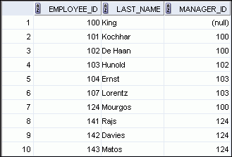
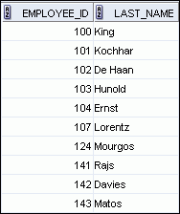
Joining a Table to Itself
EMPLOYEES (WORKER)
EMPLOYEES (MANAGER)
…
…
MANAGER_ID in the WORKER table is equal to EMPLOYEE_ID in the MANAGER table.
Notes:
Joining a Table to Itself
Sometimes you need to join a table to itself. To find the name of each employee’s manager, you need to join the EMPLOYEES table to itself, or perform a self-join. For example, to find the name of Lorentz’s manager, you need to:
Find Lorentz in the EMPLOYEES table by looking at the LAST_NAME column
Find the manager number for Lorentz by looking at the MANAGER_ID column. Lorentz’s manager number is 103.
Find the name of the manager with EMPLOYEE_ID 103 by looking at the LAST_NAME column. Hunold’s employee number is 103, so Hunold is Lorentz’s manager.
In this process, you look in the table twice. The first time you look in the table to find Lorentz in the LAST_NAME column and the MANAGER_ID value of 103. The second time you look in the EMPLOYEE_ID column to find 103 and the LAST_NAME column to find Hunold.

Slide 88
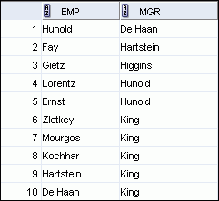
Self-Joins Using the ON Clause
SELECT worker.last_name emp, manager.last_name mgr
FROM employees worker JOIN employees manager
ON (worker.manager_id = manager.employee_id);
…
Notes:
Self-Joins Using the ON Clause
The ON clause can also be used to join columns that have different names, within the same table or in a different table.
The example shown is a self-join of the EMPLOYEES table, based on the EMPLOYEE_ID and MANAGER_ID columns.
Note: The parenthesis around the joined columns as in the slide example, (e.manager_id = m.employee_id) is optional. So, even ON e.manager_id = m.employee_id will work.

Slide 89
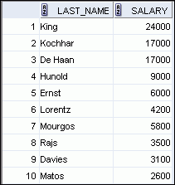
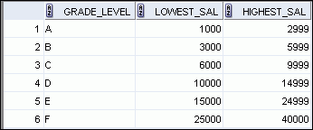
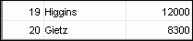
Nonequijoins
EMPLOYEES
JOB_GRADES
JOB_GRADES table defines the LOWEST_SAL and HIGHEST_SAL range of values for each GRADE_LEVEL. Hence, the GRADE_LEVEL column can be used to assign grades to each employee.
…
Notes:
Nonequijoins
A nonequijoin is a join condition containing something other than an equality operator.
The relationship between the EMPLOYEES table and the JOB_GRADES table is an example of a nonequijoin. The SALARY column in the EMPLOYEES table ranges between the values in the LOWEST_SAL and HIGHEST_SAL columns of the JOB_GRADES table. Hence, each employee can be graded based on their salary. The relationship is obtained using an operator other than the equality (=) operator.

Slide 90
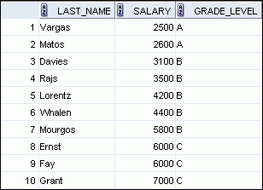
Retrieving Records with Nonequijoins
SELECT e.last_name, e.salary, j.grade_level
FROM employees e JOIN job_grades j
ON e.salary
BETWEEN j.lowest_sal AND j.highest_sal;
…
Notes:
Retrieving Records with Nonequijoins
The slide example creates a nonequijoin to evaluate an employee’s salary grade. The salary must be between any pair of the low and high salary ranges.
It is important to note that all employees appear exactly once when this query is executed. No employee is repeated in the list. There are two reasons for this:
None of the rows in the JOB_GRADES table contain grades that overlap. That is, the salary value for an employee can lie only between the low salary and high salary values of one of the rows in the salary grade table.
All of the employees’ salaries lie within the limits provided by the job grade table. That is, no employee earns less than the lowest value contained in the LOWEST_SAL column or more than the highest value contained in the HIGHEST_SAL column.
Note: Other conditions (such as <= and >=) can be used, but BETWEEN is the simplest. Remember to specify the low value first and the high value last when using the BETWEEN condition. The Oracle server translates the BETWEEN condition to a pair of AND conditions. Therefore, using BETWEEN has no performance benefits, but should be used only for logical simplicity.
Table aliases have been specified in the slide example for performance reasons, not because of possible ambiguity.

Slide 91
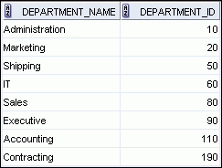
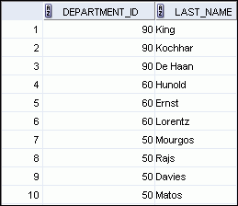
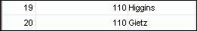
Returning Records with No Direct Match with Outer Joins
DEPARTMENTS
EMPLOYEES
…
There are no employees in department 190.
To return the department record that does not have any employees or employees that do not have an assigned department, you can use an outer join.
Notes:
Returning Records with No Direct Match with Outer Joins
If a row does not satisfy a join condition, the row does not appear in the query result. For example, in the equijoin condition of EMPLOYEES and DEPARTMENTS tables, department ID 190 does not appear because there are no employees with that department ID recorded in the EMPLOYEES table. Therefore, instead of seeing 20 employees in the result set, you see 19 records.
To return the department record that does not have any employees, you can use an outer join.

Slide 92
INNER Versus OUTER Joins
In SQL:1999, the join of two tables returning only matched rows is called an inner join.
A join between two tables that returns the results of the inner join as well as the unmatched rows from the left (or right) table is called a left (or right) outer join.
A join between two tables that returns the results of an inner join as well as the results of a left and right join is a full outer join.
Notes:
INNER Versus OUTER Joins
Joining tables with the NATURAL JOIN, USING, or ON clauses results in an inner join. Any unmatched rows are not displayed in the output. To return the unmatched rows, you can use an outer join. An outer join returns all rows that satisfy the join condition and also returns some or all of those rows from one table for which no rows from the other table satisfy the join condition.
There are three types of outer joins:
LEFT OUTER
RIGHT OUTER
FULL OUTER

Slide 93
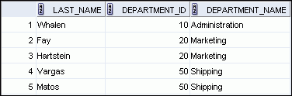
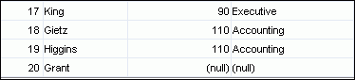
LEFT OUTER JOIN
SELECT e.last_name, e.department_id, d.department_name
FROM employees e LEFT OUTER JOIN departments d
ON (e.department_id = d.department_id) ;
…
This query retrieves all rows in the EMPLOYEES table, which is the left table,
even if there is no match in the DEPARTMENTS table.
Notes:
LEFT OUTER JOIN
This query retrieves all rows in the EMPLOYEES table, which is the left table, even if there is no match in the DEPARTMENTS table.

Slide 94
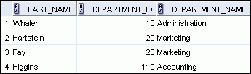
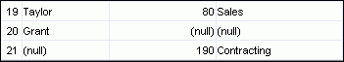
RIGHT OUTER JOIN
SELECT e.last_name, e.department_id, d.department_name
FROM employees e RIGHT OUTER JOIN departments d
ON (e.department_id = d.department_id) ;
…
This query retrieves all rows in the DEPARTMENTS table, which is the right table,
even if there is no match in the EMPLOYEES table.
Notes:
RIGHT OUTER JOIN
This query retrieves all rows in the DEPARTMENTS table, which is the right table, even if there is no match in the EMPLOYEES table.

Slide 95
FULL OUTER JOIN
SELECT e.last_name, d.department_id, d.department_name
FROM employees e FULL OUTER JOIN departments d
ON (e.department_id = d.department_id) ;
…
Notes:
FULL OUTER JOIN
This query retrieves all rows in the EMPLOYEES table, even if there is no match in the DEPARTMENTS table. It also retrieves all rows in the DEPARTMENTS table, even if there is no match in the EMPLOYEES table.

Slide 96
Cartesian Products
A Cartesian product is formed when:
A join condition is omitted
A join condition is invalid
All rows in the first table are joined to all rows in the second table
To avoid a Cartesian product, always include a valid join condition.
Notes:
Cartesian Products
When a join condition is invalid or omitted completely, the result is a Cartesian product, in which all combinations of rows are displayed. All rows in the first table are joined to all rows in the second table.
A Cartesian product tends to generate a large number of rows and the result is rarely useful. You should, therefore, always include a valid join condition unless you have a specific need to combine all rows from all tables.
However, Cartesian products are useful for some tests when you need to generate a large number of rows to simulate a reasonable amount of data.

Slide 97
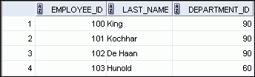
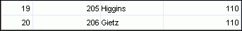
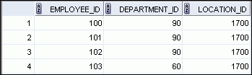

Generating a Cartesian Product
EMPLOYEES (20 rows)
DEPARTMENTS (8 rows)
…
Cartesian product: 20 x 8 = 160 rows
…
Notes:
Generating a Cartesian Product
A Cartesian product is generated if a join condition is omitted. The example in the slide displays the employee last name and the department name from the EMPLOYEES and DEPARTMENTS tables. Because no join condition was specified, all rows (20 rows) from the EMPLOYEES table are joined with all rows (8 rows) in the DEPARTMENTS table, thereby generating 160 rows in the output.

Slide 98


Creating Cross Joins
The CROSS JOIN clause produces the cross-product of two tables.
This is also called a Cartesian product between the two tables.
SELECT last_name, department_name
FROM employees
CROSS JOIN departments ;
…
Notes:
Creating Cross Joins
The example in the slide produces a Cartesian product of the EMPLOYEES and DEPARTMENTS tables.

Slide 99
Summary
In this lesson, you should have learned how to use joins to display data from multiple tables by using:
Equijoins
Nonequijoins
Outer joins
Self-joins
Cross joins
Natural joins
Full (or two-sided) outer joins
Notes:
Summary
There are multiple ways to join tables.
Types of Joins
Equijoins
Nonequijoins
Outer joins
Self-joins
Cross joins
Natural joins
Full (or two-sided) outer joins
Cartesian Products
A Cartesian product results in the display of all combinations of rows. This is done by either omitting the WHERE clause or by specifying the CROSS JOIN clause.
Table Aliases
Table aliases speed up database access.
Table aliases can help to keep SQL code smaller by conserving memory.
Table aliases are sometimes mandatory to avoid column ambiguity.

Slide 100

Databasis en tabelle (I-34 tot I-35)

Slide 101
Practice 6: Exercise
Write a query for the HR department to produce the addresses of all the departments. Use
the LOCATIONS and COUNTRIES tables. Show the location ID, street address, city, state or
province, and country in the output. Use a NATURAL JOIN to produce the results.
Notes:
Practice 6: Overview
This practice is intended to give you experience in extracting data from more than one table using the SQL:1999–compliant joins.

Slide 102
Practice 6: Exercise MEMO
SELECT location_id, street_address, city, state_province, country_name
FROM locations
NATURAL JOIN countries;
Notes:
Practice 6: Overview
This practice is intended to give you experience in extracting data from more than one table using the SQL:1999–compliant joins.

Slide 103
Practice 6: Exercise
The HR department needs a report of all employees. Write a query to display the last name, department number, and department name for all the employees.
Notes:
Practice 6: Overview
This practice is intended to give you experience in extracting data from more than one table using the SQL:1999–compliant joins.

Slide 104
Practice 6: Exercise MEMO
SELECT last_name, department_id, department_name
FROM employees
JOIN departments
USING (department_id);
Notes:
Practice 6: Overview
This practice is intended to give you experience in extracting data from more than one table using the SQL:1999–compliant joins.

Slide 105
Practice 6: Exercise
The HR department needs a report of employees in Toronto. Display the last name, job,
department number, and department name for all employees who work in Toronto.
Notes:
Practice 6: Overview
This practice is intended to give you experience in extracting data from more than one table using the SQL:1999–compliant joins.

Slide 106
Practice 6: Exercise MEMO
SELECT e.last_name, e.job_id, e.department_id, d.department_name
FROM employees e JOIN departments d
ON (e.department_id = d.department_id)
JOIN locations l
ON (d.location_id = l.location_id)
WHERE LOWER(l.city) = 'toronto';
Notes:
Practice 6: Overview
This practice is intended to give you experience in extracting data from more than one table using the SQL:1999–compliant joins.

